Slide 1
Module 4. Page Management

Slide 2
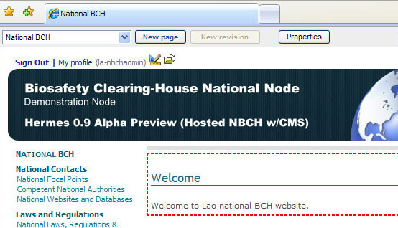

4.2 Creating New Pages
Child pages can be created by clicking on the "New Page” button.
CLICK HERE

Slide 3
4.2 Creating New Pages
Note:
Pages are organized hierarchically.
You need to go to the parent page to create a sibling page.
To illustrate, an example will be shown on the succeeding slides on how to add new pages.

Slide 4
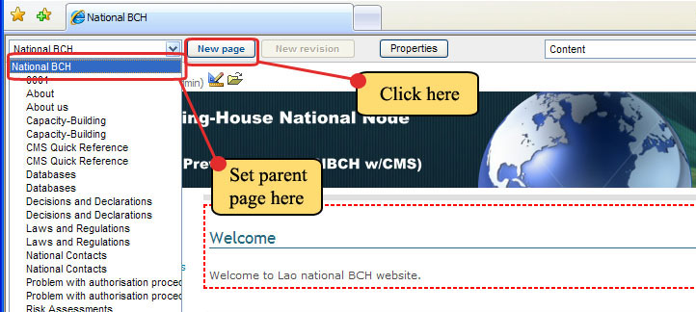
4.2 Creating New Pages
Example. Creating a new child page entitled Lao People’s Democratic Republic.
Step 1. Set parent page to National BCH, as shown below. Then click the New Page button.

Slide 5
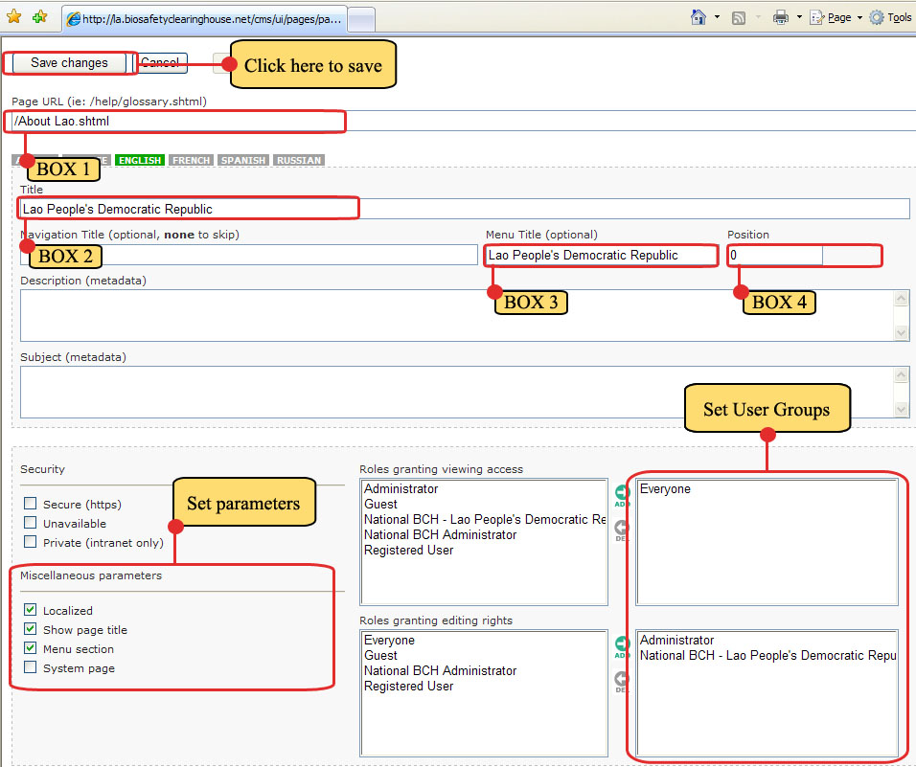
4.2 Creating New Pages
Step 2. The Page property of the New Page will appear. Now, set the proper values for the items found on the page.

Slide 6
4.2 Creating New Pages
BOX 1 – Page URL: /About Lao.shtml
BOX 2 – Title: Lao People’s Democratic Republic
BOX 3 – Menu Title (optional): Lao People’s Democratic Republic
BOX 4 – Position: 0 (zero)
SET MISCELLANEOUS PARAMETERS –
  Check the following boxes: Localized, Show page title, Menu section

Slide 7
4.2 Creating New Pages
SET USER GROUPS FOR ROLES GRANTING
  Roles granting viewing access – Everyone.
  Roles granting editing rights – Administrator and National BCH – Lao People’s Democratic Republic.
Lastly, click Save Changes button to enable the settings.

Slide 8
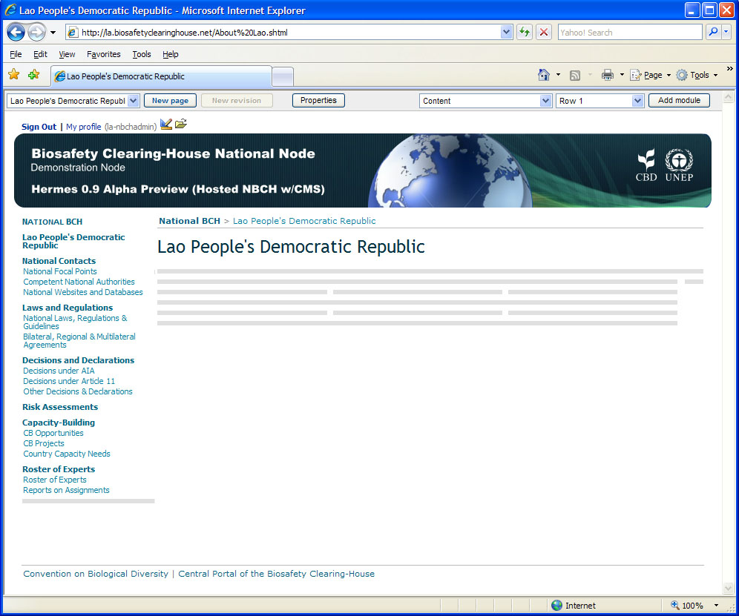




4.2 Creating New Pages
After saving, a new page will appear and observe the following.
BOXES 3 and 4 settings results into the Menu Title - Lao People’s Democratic Republic to appear just below the NATIONAL BCH Main title.
When POSITION is set to 0 (zero), the menu title would normally appear just below the home page title, i.e. NATIONAL BCH.
BOX 2 setting
Title: Lao People’s Democratic Republic
Page URL
Setting

